Slide 1
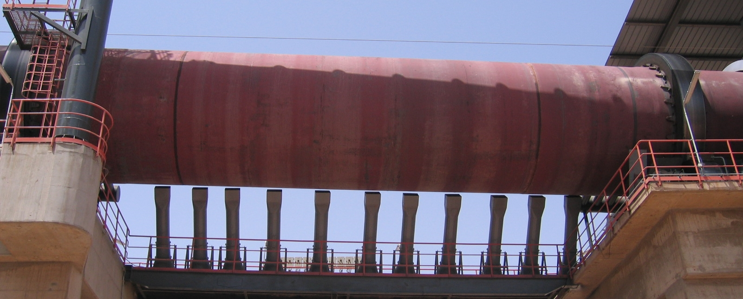
Introduction Thermal Energy / Thermal Technology
Technical Development Program for Process Performance Engineers – SPREAD 2016
Mirko Weber

Slide 2
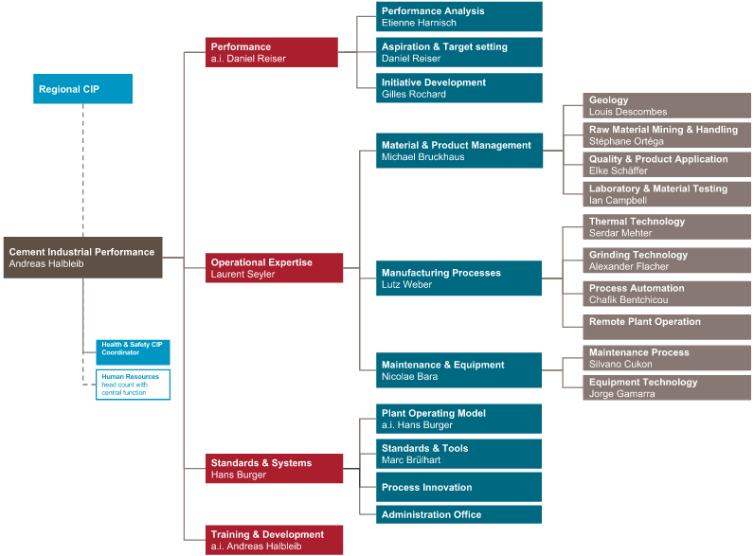
Organization Chart of Cement Manufacturing

Slide 3
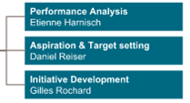
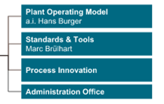
Organization Chart of Cement Manufacturing
next slide

Slide 4
Organization Chart of Cement Manufacturing

Slide 5
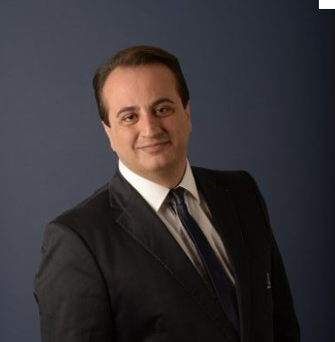
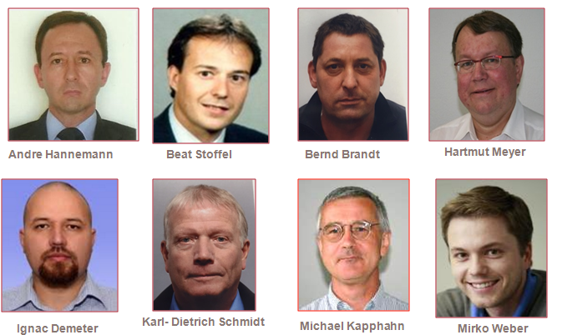
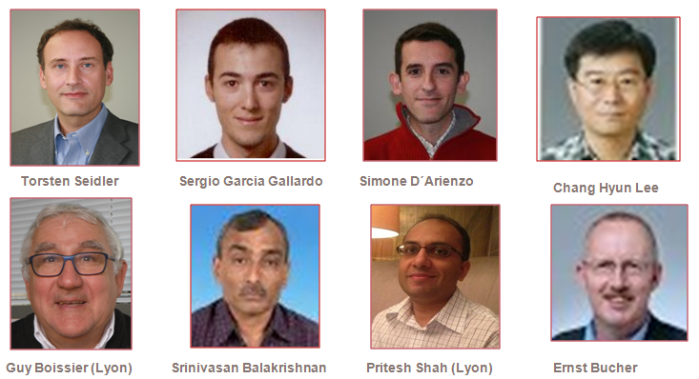
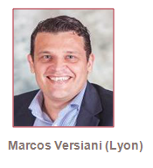
cCIP Thermal Technology Group
Thermal Technology
Serdar Mehter
?
SPREAD 2016 supported by Minerva Lopez, Grinding Technology cCIP Hazem Yousry, Process & Production, rCIP MEA
Stefan Gross, Grinding Technology cCIP

Slide 6
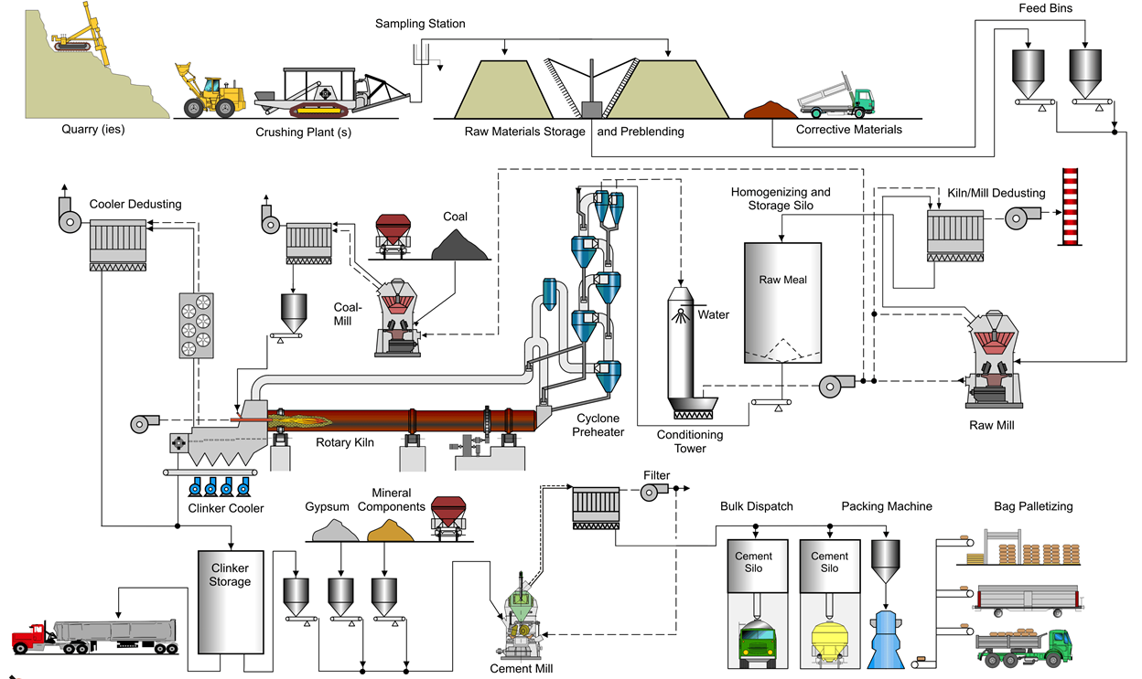
Thermal Technology Scope
6

Slide 7
Thermal Technology - Knowhow Areas
Emission control technology
Gas flow
Kiln systems
Dust control equipment (large process filters): Bagfilters, ESP, Cyclones
SNCR, SCR
Wet scrubbers (SO2, HCl)
Dry reagent injection (SO2, HCl, Hg, VOC)
Regenerative thermal oxidizer (VOC, CO)
Carbon Capture Technology
Gas flow concept
Dust management concept
Process fans
Air-to-air HEX
Conditioning tower
Stacks
Gas flow control equipment
Acid corrosion (stack, filter)
Kiln system concepts
Rotary kiln (process aspects)
Preheater
Pre-calciner
Cooler (incl clinker crusher)
Bypass
Feed and firing
Refractory
High Level Control/ Kiln Master
Fine coal silo (incl ATEX) and feed system
Main burner
Calciner burner
Preheater cleaning equipment
Raw material dosing
Material selection/ installation concept
Performance/ operation
Hot corrosion (rotary kiln, PH)
HLC performance assessment
KM Installation and maintenance
KM Development
Operation and control
Thermal Energy
Operation concept ( incl set-points)
Circulation phenomena
Semi-wet, wet, semi-dry technology
White cement
Process requirements for sampling, instrumentation and actuators (incl measurement locations)
Main control loops
SOPs
Interlocks
Heat consumption benchmark
Traditional fuels
7

Slide 8
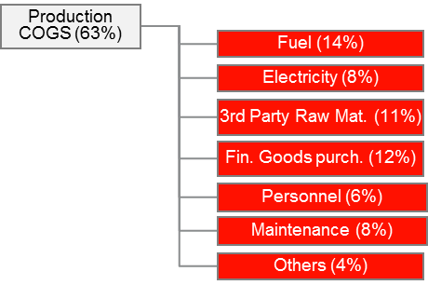
Thermal Energy has a significant cost contribution
Energy costs represent 22% (14% TE) of the cost impact on operating EBITDA (Holcim 2013)
Focusing on total production costs (Costs Of Goods Sold) the energy part accounts for totally 35% (22% TE)
100%
22%
Distribution COGS (26%)
Marketing and sales (3%) Administration (8%)
13%
8

Slide 9
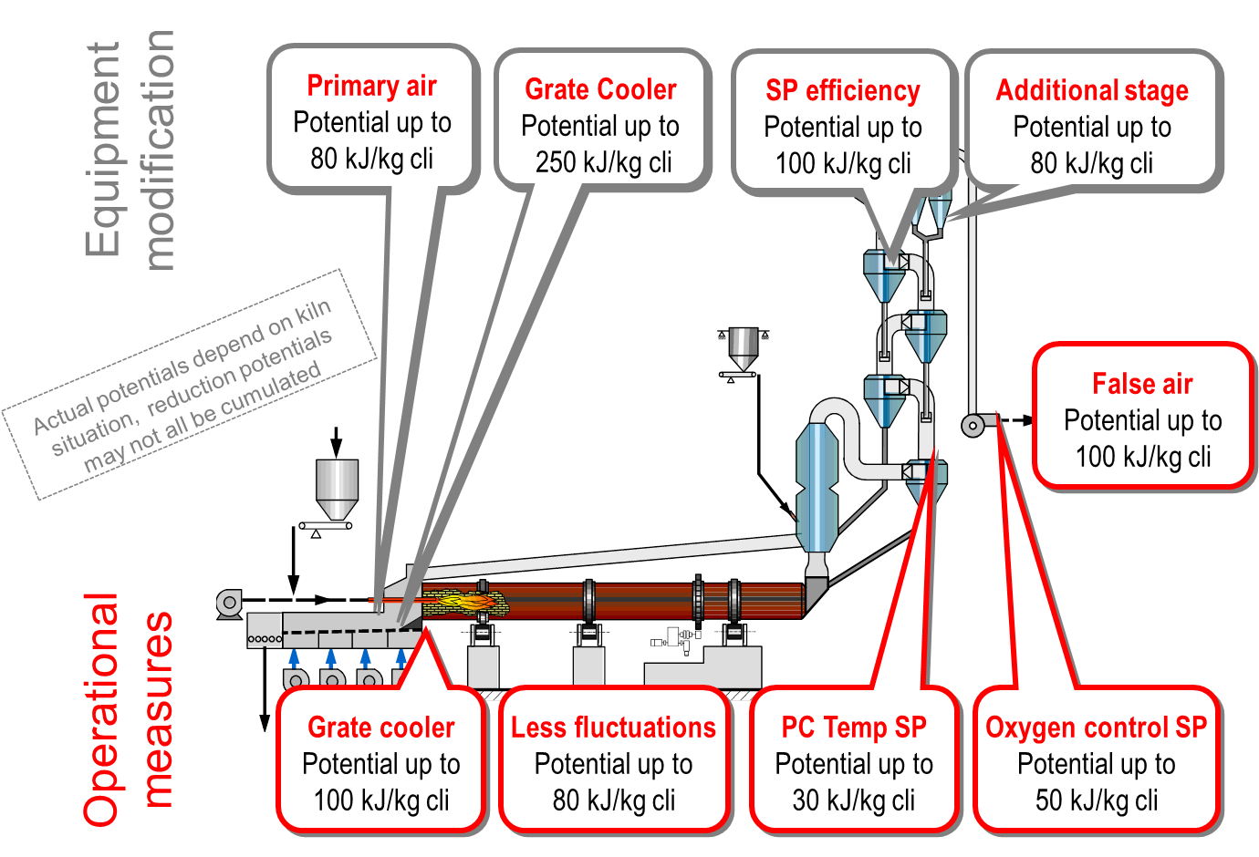
Heat reduction potential by operational measures, raw mix and fuels (quality, fluctuations) & equipment modification
+ MTBF
9

Slide 10
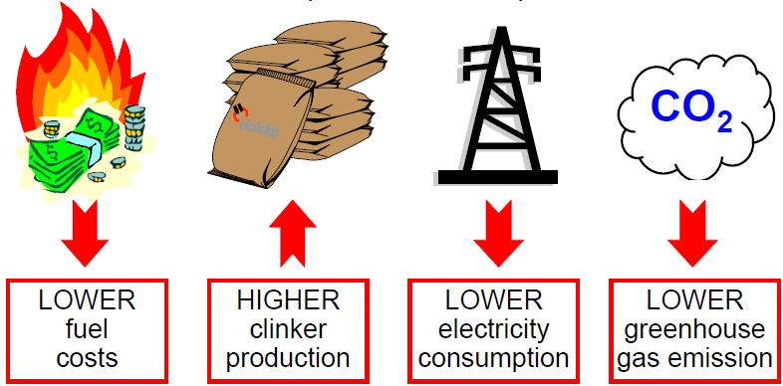
Thermal Energy reduction can lead to various benefits
10

Slide 11
Process Engineers certification projects «PPE» Projects 2015 about thermal process
3 PPE projects reduced mainly thermal and electrical energy consumption
Measures for false air reduction, preheater modifications, cooler operation and optimization, process optimization, Kiln Master, training
2 PPE projects dealt with fuel mix optimization / AFR
Increase of use of Petcoke or AFR by optimizing e.g. raw material, kiln operation incl. operator training
3 PPE projects dealt with improvement of production rate
Optimization of kiln operation
11

Slide 12
Calculated/estimated benefits of PPE thermal projects in 2014 (USD)
Reduced thermal/electrical energy consumption
Emission reduction
Fuel mix optimization and AFR
Clinker quality increase
Total annual benefit of thermal projects
Annual benefit 3’070’000 $
Annual benefit 2’200’000 $
Annual benefit 2’830’000 $
Annual benefit 2’000’000 $
10’100’000 $
12

Slide 13
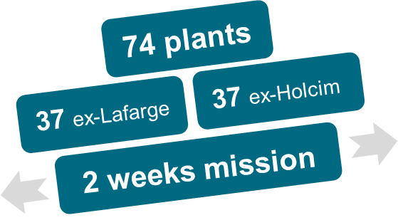
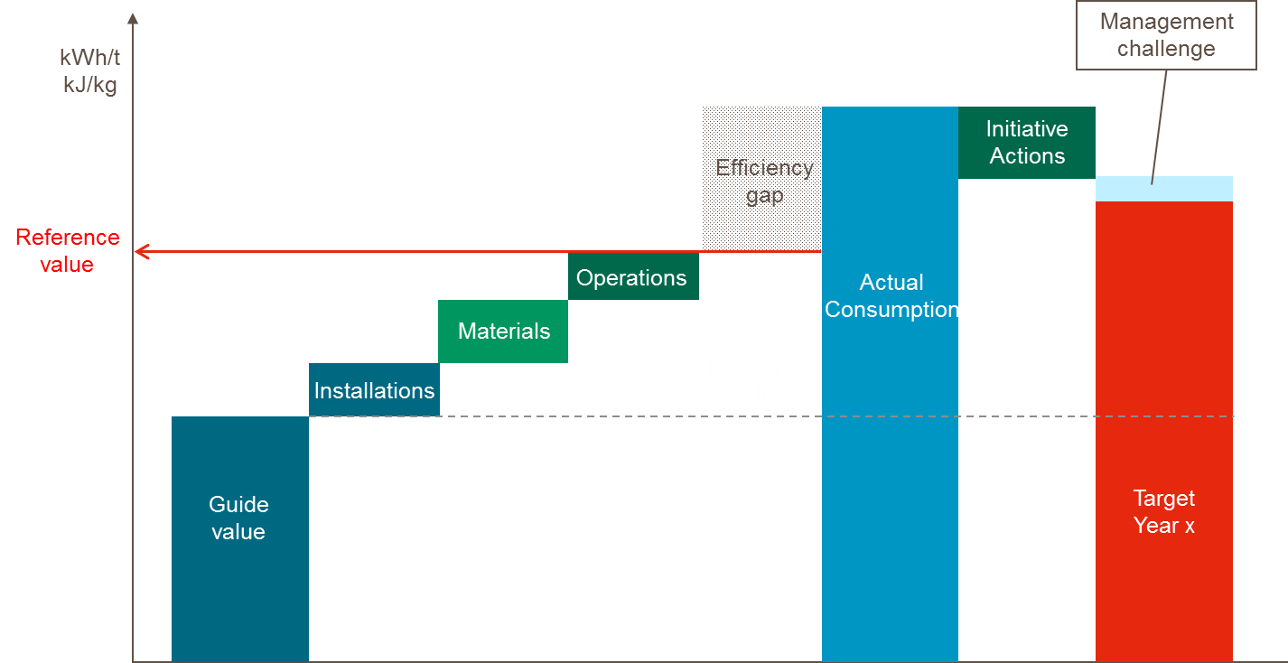
Current priorities Thermal Group
Synergy Task Forces (SATF)
Committed SATF benefits @ end of missions resulted to 223 mCHF
Expected benefits for 2016 of ALL SATF plants are 145 mCHF
Harvest the money
On site follow up missions
Task forces for priority plants
Initiatives
Fuel Mix, use of petcoke
Industrial Fix Cost
Energy Consumption
STEC
SEEC
Notes:
Delivering on a Euro1.4bn synergy target within three years - through synergies in manufacturing, procurement, sales, corporate, deployment of innovations, financing, CAPEX

Slide 14

Questions
…or comments?
14

Slide 15
